Slide 1
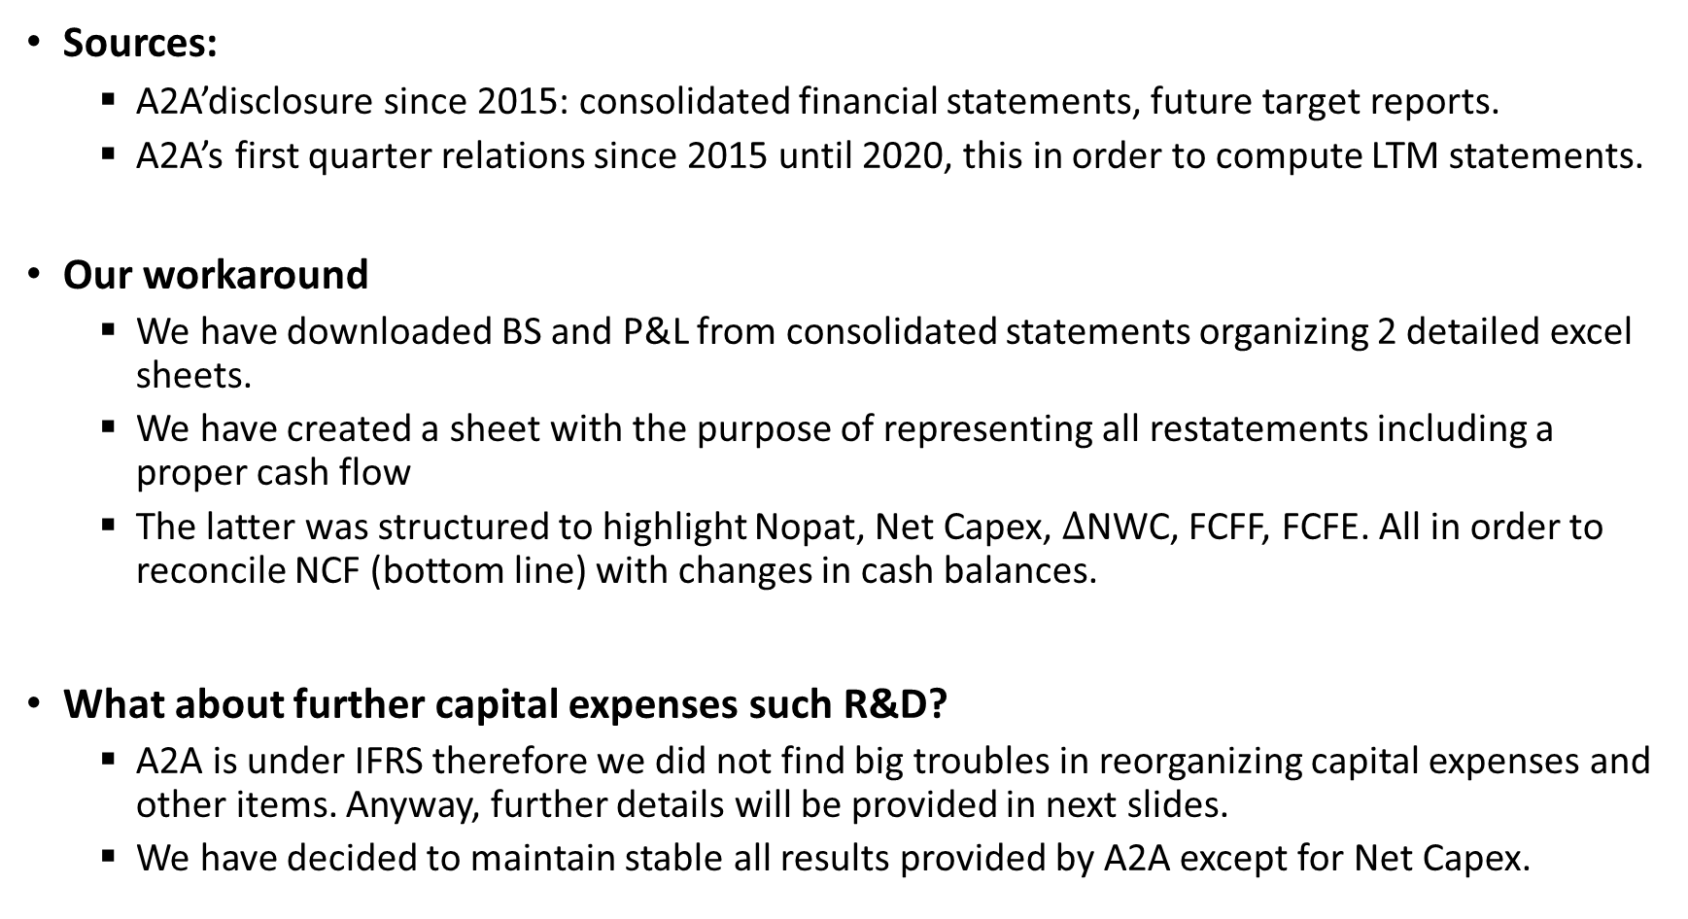
A2A Reorganized Financial Statements
Sources:
A2A’disclosure since 2015: consolidated financial statements, future target reports.
A2A’s first quarter relations since 2015 until 2020, this in order to compute LTM statements.
Our workaround
We have downloaded BS and P&L from consolidated statements organizing 2 detailed excel sheets.
We have created a sheet with the purpose of representing all restatements including a proper cash flow
The latter was structured to highlight Nopat, Net Capex, $∆$NWC, FCFF, FCFE. All in order to reconcile NCF (bottom line) with changes in cash balances.
What about further capital expenses such R&D?
A2A is under IFRS therefore we did not find big troubles in reorganizing capital expenses and other items. Anyway, further details will be provided in next slides.
We have decided to maintain stable all results provided by A2A except for Net Capex.

Slide 2
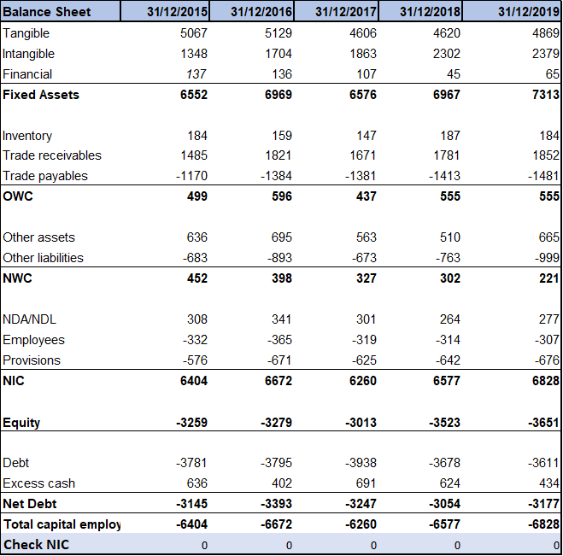
Reorganized financial statements: Overview (1)
Details
Financial: composed by shareholdings and non-current financial assets.
OWC: includes only inventory, trade receivables and payables, no cash.
Other assets and liabilities such as other non-current financial assets or tax liabilities are all included in what we called Net Working Capital (NWC).
Residual items: net deferred taxes, provisions for risks and employees’ benefits.
Summing Fixed assets, NWC, and residual items we arrive to Net Invested Capital (Denominator for Roic).
Equity is maintained equal to reported book values.
Debt, differently from A2A reorganization, includes only S/T and M/L term financial liabilities (Bonds and other financing).
Netting out cash balances we arrive to Net Debt (NFP).
NOTICE: We did not expense any R&D in order to get value for Research asset and we did not conver operating leases into debt. It follows that we did not adjust Operating Income.

Slide 3
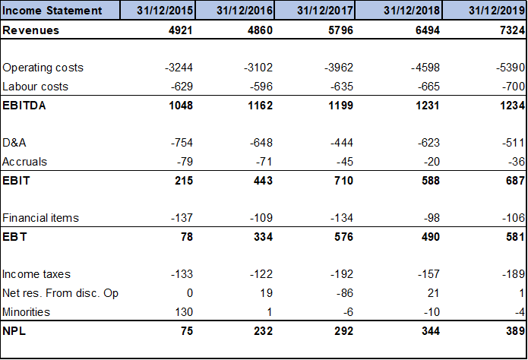
Reorganized financial statements: Overview (2)
Details
Revenues include both operating revenues (sales) and other operating ones.
Operating costs include materials, services and other operating expenses.
Financial items represent the net value obtained summing results from non-recurring transactions and financial balance.
Items below EBT are the same presented in consolidated income statement.
In our analysis we used NPL corresponding to group result of the year.
Comment: It can be observed that since 2016 there has been a costant upward trend for NPL whereas EBIT was more volatile.

Slide 4
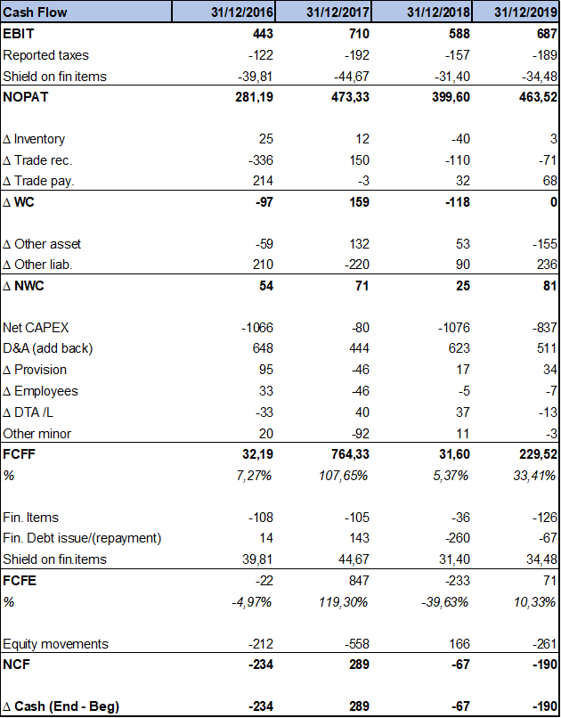
Reorganized financial statements: restated Cash Flow (1)
Details
We started from EBIT, subtracting reported taxes and an additive component: taxes company would have paid if full equity (at effective tax rate).
In this way we obtained Nopat.
Then, we highlighted changes in WC and further in NWC: positive changes had a negative impact in cash and viceversa.
Net Capex was obtained considering changes in Tangibles and intangibles and adding current D&A. Obviously its contribute on cash flows was negative.
Then, D&A was subtracted, non-cash cost which would have been counted two times otherwise.
We also considered changes in residual items.
For other minor we have considered two items in income statement: minorities and net result from discontinued operations.
Adding all these figures we obtained Free Cash Flow to equity for each year, starting from 2016.

Slide 5
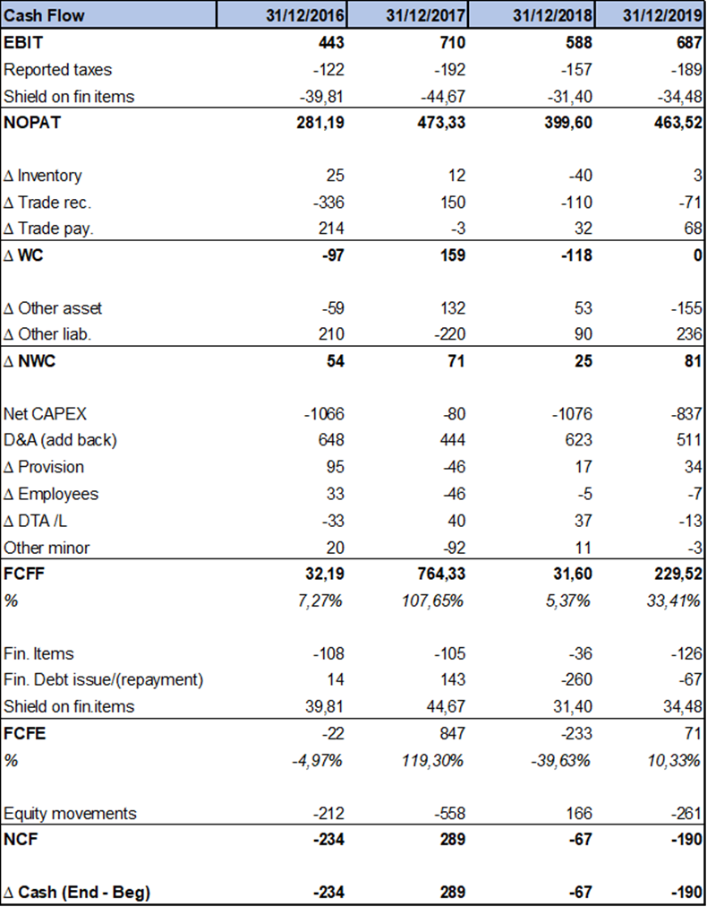
Reorganized financial statements: restated Cash Flow (2)
Then, we subtracted financial items: figures from Income Statement were enlarged by changes in financial fixed assets.
We highlighted changes in financial debt: positive impact if new issues were higher than repayments.
We neutralized effect of shield on financial items arriving to Free Cash Flow To Equity (FCFE).
Finally, from FCFE we added/subtracted equity movements: obtained by subtracting current NI to changes in equity book value.
Bottom line represents Net Cash Flow (NCF) which must be equal to effective changes in cash balances during the analysed year.

Slide 6
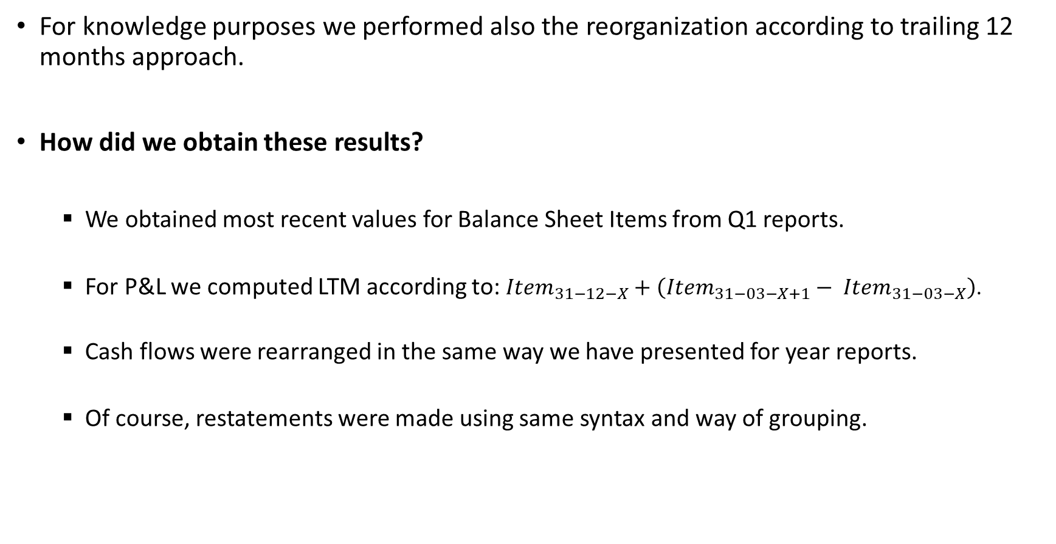
Reorganized Statements: trailing 12 months
For knowledge purposes we performed also the reorganization according to trailing 12 months approach.
How did we obtain these results?
We obtained most recent values for Balance Sheet Items from Q1 reports.
For P&L we computed LTM according to: ${Item}_{31−12−X}+\left({Item}_{31−03−X+1}− {Item}_{31−03−X}\right)$.
Cash flows were rearranged in the same way we have presented for year reports.
Of course, restatements were made using same syntax and way of grouping.

Slide 7
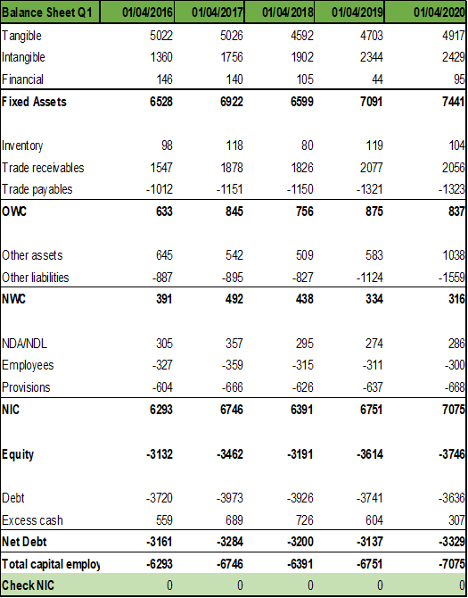
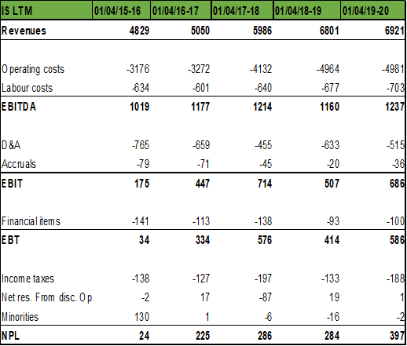
Trailing 12 months: overview (1)
Balance Sheet (from quarterly reports)
LTM P&L (according to previous formula)

Slide 8
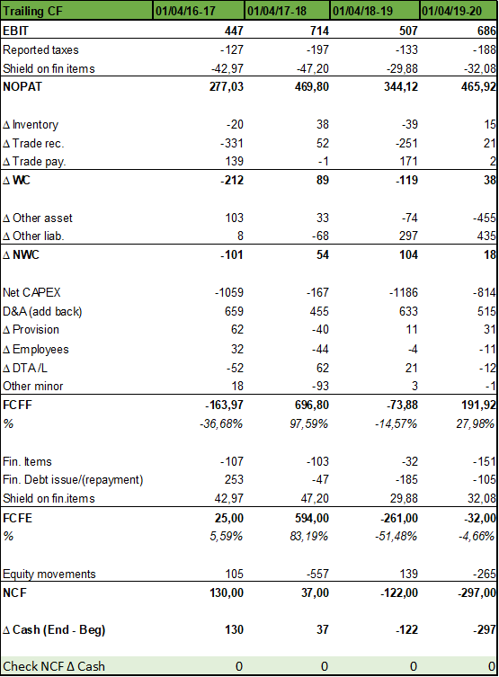
Trailing 12 months: overview (2)
All presented results allow us to get more updated information.
NOTICE: For consistency reasons we did not used in our valuation analysis, this because in computational procedures we considered data time series until 31/12/2019.
Comments
It’s interesting to notice the Covid19 effect in LTM Income statement: revenues reported are slightly lower. This comes from the fact that reported values in Q1 2020 were lower than Q1 2019 reducing values in consolidated report for 2019.
Anyway, in terms of EBITDA and EBIT this was diluted by drop in operational expenses: operational results are slightly better than in the year report.

